Slide 1
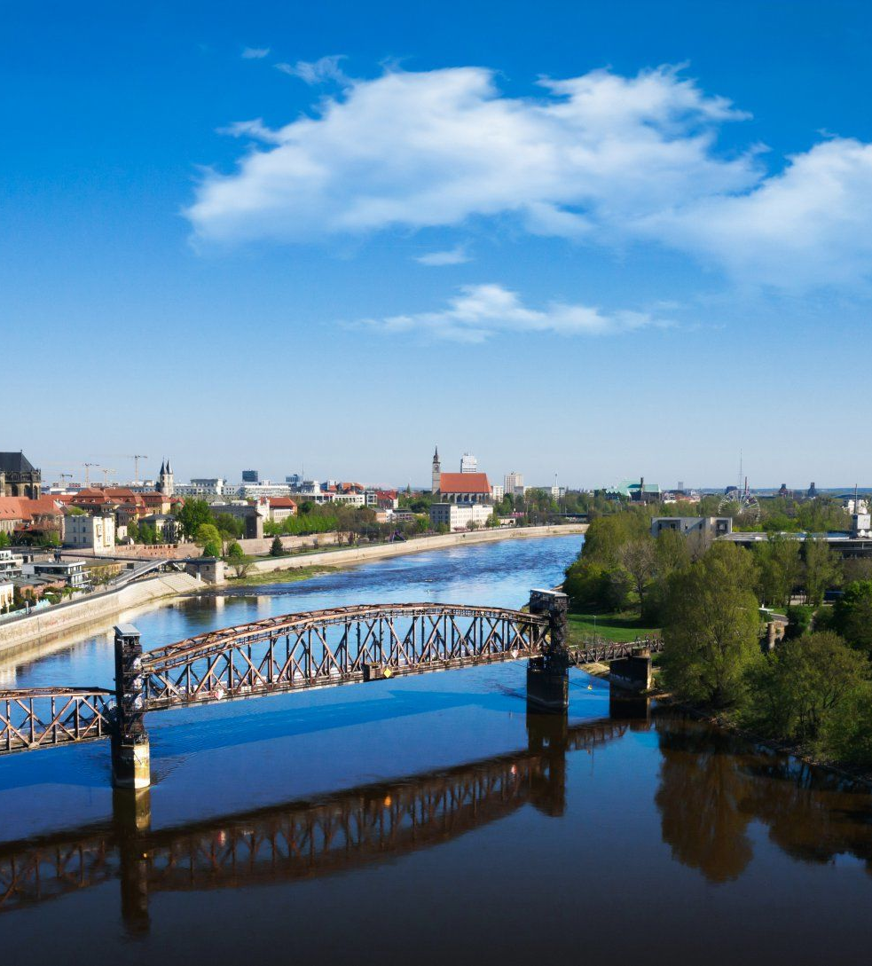
Simulation Project – Team Tetrahedron
Milestone #7 - Experiments
Image source: https://cdn.ottopix.de/wp-content/uploads/2019/04/Magdeburg-Panorama-%C3%BCber-der-Hubbr%C3%BCcke.jpg

Slide 2
Agenda
Simulation Project - Team D
Milestone #7 - Experiments
01
02
Goals & Claims
Experiments
Goals of the milestone and output variables calculated.
An overview and results of the experiments performed.
03
04
Recommendation
Cost & Progress
Our recommendation for customer.
A glimpse about the progress we made so far.

Slide 3
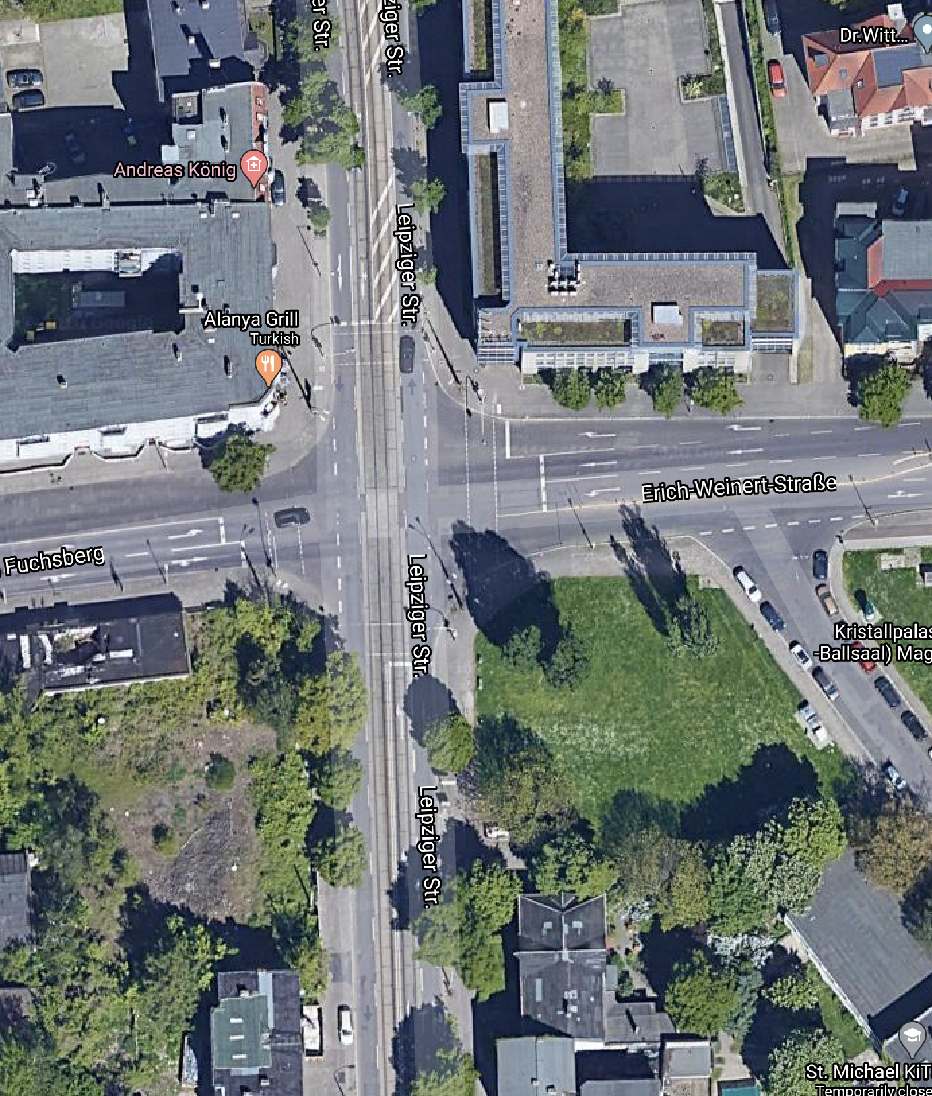
Abbreviations
Simulation Project - Team D
Milestone #7 - Experiments
01
Leipziger Strasse North :- LSN
02
Leipziger Strasse South :- LSS
03
Erich-Weinert-Strasse :- EWS
04
Am Fuchsberg :- AF

Slide 4
01
Goals & Claims
Simulation Project - Team D
Milestone #7 - Experiments
Goals of the milestone and the claims we made for the existing system.

Slide 5


Goals
Simulation Project - Team D
Milestone #7 - Experiments
01
Improve traffic condition and reduce congestion
A
Throughput :- Cars going out in one hour
B
Time in Model :- Time(in seconds) a car took to go from source to sink
C
Queue Length at Signal :- Avg. number of car waiting at signal
02
Improve safety Condition
A
Car Stop Count at Intersection :- Total count of car stops inside intersection

Slide 6
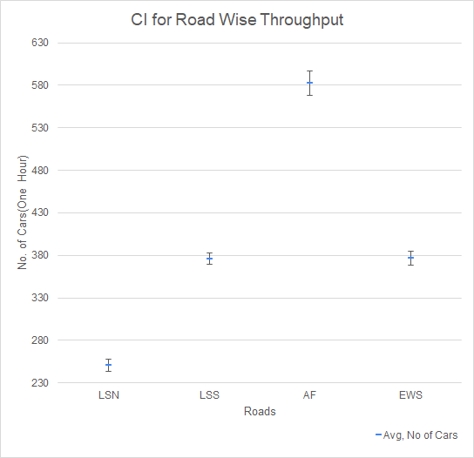
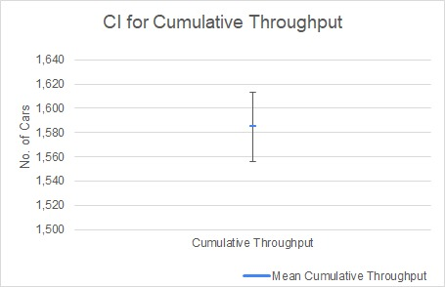
Claims
Simulation Project - Team D
Milestone #7 - Experiments
01
Throughput is very less - compared to expected number of cars to be injected into the system
LSN CI 244-258
LSS CI 369-382
AF CI 568-597
EWS CI 368-384
Cumulative Throughput CI
1556-1613
Mean 1585

Slide 7
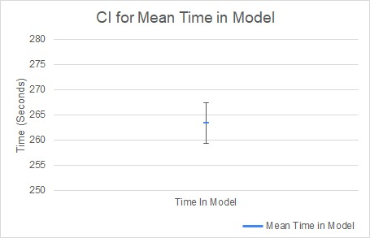
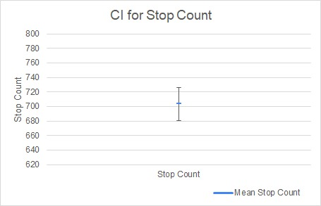
Claims Continued ...
Simulation Project - Team D
Milestone #7 - Experiments
02
Cars move slow : Time in model is high
03
Not very safe -Number of time cars stopping at node intersection is high
Mean 263 Seconds
CI 259-267 Seconds
Mean 704
CI 681-726

Slide 8
02
Experiments
Simulation Project - Team D
Milestone #7 - Experiments
Our experiments and their results

Slide 9
Statement of Accuracy
Simulation Project - Team D
Milestone #7 - Experiments
Replications :- 100 replications per iteration
Randomness :- Unique seed for each simulation run
Precision :- 99% confidence interval for each output variable

Slide 10
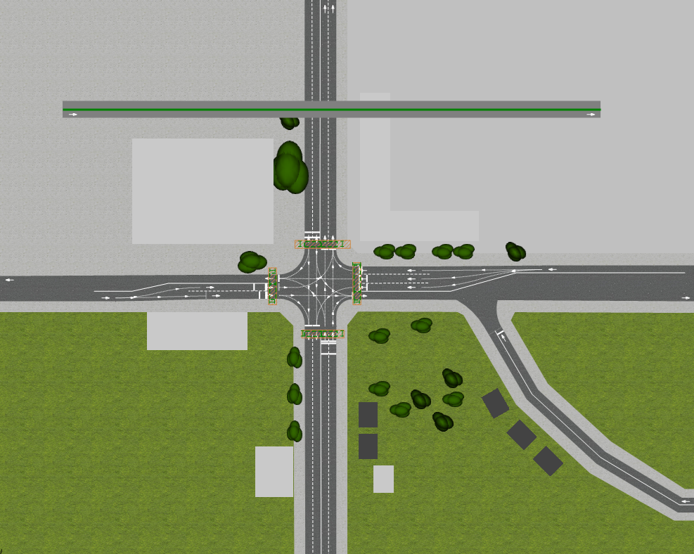
Experiment 1
Simulation Project - Team D
Milestone #7 - Experiments
Details: Constructing a bridge for cars going straight on either direction between Am Fuchsberg and Erich-Weinert strasse
Goal: Increase throughput by allowing cars bypassing the traffic signal and congestion.

Slide 11
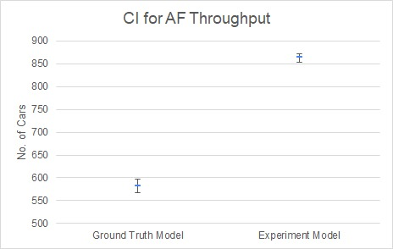
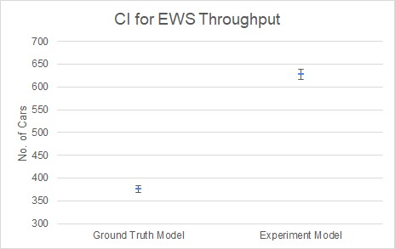
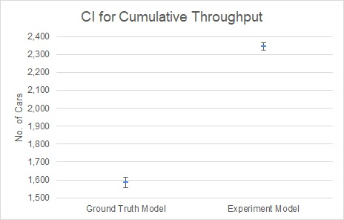
Outcome
Simulation Project - Team D
Milestone #7 - Experiments
Throughput Comparison
Base Model:
Mean 582
CI 568- 597
Experiment:
Mean 864
CI 854-872
Base Model:
Mean 376
CI 368- 384
Experiment:
Mean 627
CI 616-638
Base Model:
Mean 1585
CI 1556- 1613
Experiment:
Mean 2343
CI 2322-2363
LSN throughput mean Jumped from 251 to 349
LSS throughput mean Jumped from 375 to 502

Slide 12
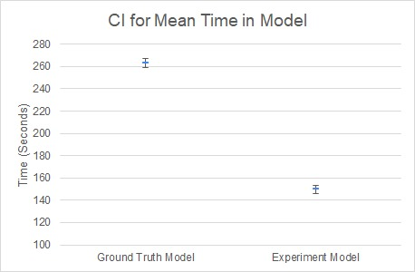
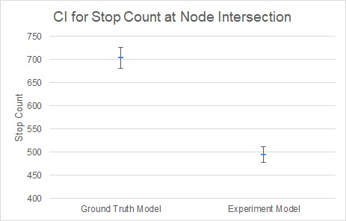
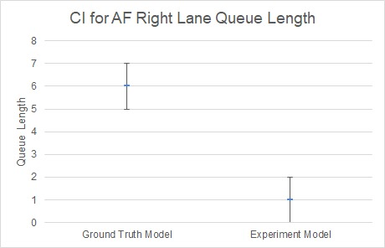
Impact on -
Simulation Project - Team D
Milestone #7 - Experiments
Time in Model
Safety
Queue Length
Base Model:
Mean 263
CI 259-267
Experiment:
Mean 150
CI 146-153
Base Model:
Mean 704
CI 681-726
Experiment:
Mean 494
CI 478-511
Base Model:
Mean 6
CI 5-7
Experiment:
Mean 1
CI 0-2

Slide 13
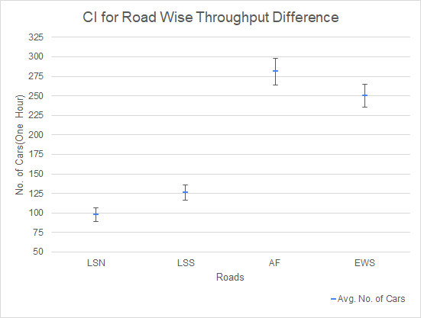
Statistical Significance
Simulation Project - Team D
Milestone #7 - Experiments
CI for (throughput in experiment model - ground truth model)

Slide 14
Experiment 2
Simulation Project - Team D
Milestone #7 - Experiments
Details: Change in traffic light phase and timing for cars and pedestrians.
Goal: Increase safety by reducing the amount of cars stopping at the main intersection
Directions | 33 | 2 | 24 | 2 | 40 | 2 | 17 | 2
Cars going straight and turning right from LSS and LSN
Cars going left from LSS and LSN
Cars going straight and turning right from AF and EWS
Cars going left from AF and EWS

Slide 15
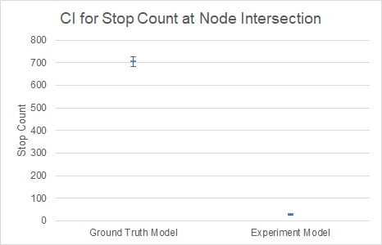
Outcome
Simulation Project - Team D
Milestone #7 - Experiments
Stop Count Comparison
Base Model:
Mean 704
CI 681- 726
Experiment:
Mean 28
CI 24 - 31

Slide 16
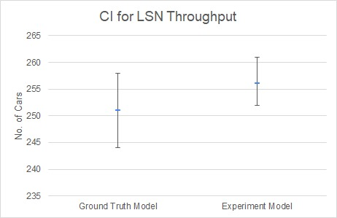
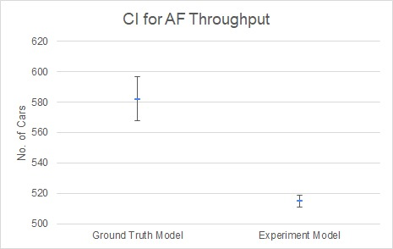
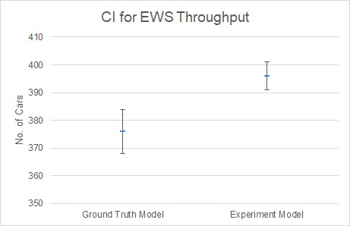
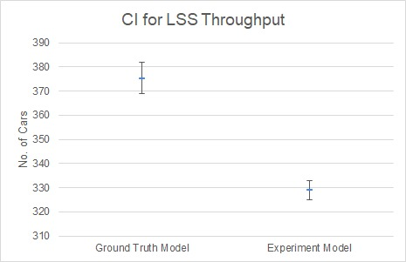
Impact on -
Simulation Project - Team D
Milestone #7 - Experiments
Throughput
Base Model:
Mean 582
CI 568- 597
Experiment:
Mean 515
CI 511-519
Base Model:
Mean 376
CI 368- 384
Experiment:
Mean 396
CI 391-401

Slide 17
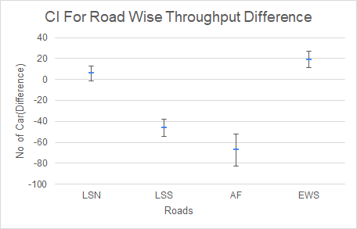
Statistical Significance
Simulation Project - Team D
Milestone #7 - Experiments
CI for (throughput in experiment model - ground truth model)

Slide 18


Other Experiments
Simulation Project - Team D
Milestone #7 - Experiments
Experiments | Traffic Improvement | Safety Improvement
Allow car traffic on the blocked tram line in Leipziger Strasse North
Include a free lane to turn right for cars from Leipziger str. to Erich-Weinert str.
Vary traffic light sequence to search for optimal waiting times and traffic flow.
Open traffic signal only for one road at a single point of time.

Slide 19
03
Recommendation
Simulation Project - Team D
Milestone #7 - Experiments
Our recommendation for customer

Slide 20
Our Recommendations
Simulation Project - Team D
Milestone #7 - Experiments
Recommendations | Cost | Improvements
Open opposite not overlapping signals for cars | Low | Highly significant safety improvement
All cars to go on blocked tram lane on LSN | Medium | Average traffic condition improvement
Make a bridge or underpass for cars going straight in between AF and EWS | Very High | Highly significant traffic improvement along with average safety improvement

Slide 21
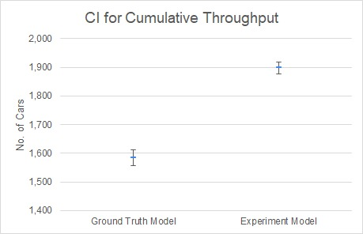
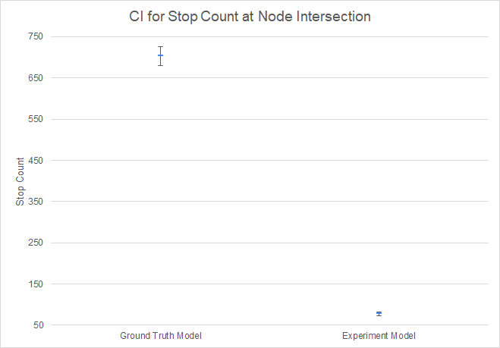
Outcome
Simulation Project - Team D
Milestone #7 - Experiments
Throughput Comparison
Stop Count Comparison
Base Model:
Mean 1585
CI 1556-1613
Experiment:
Mean 1899
CI 1878-1919
Base Model:
Mean 704
CI 681-726
Experiment:
Mean 78
CI 73-82

Slide 22
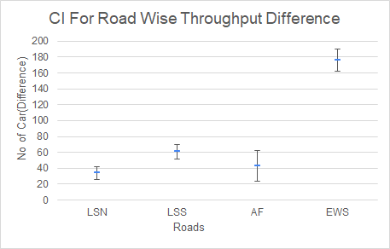
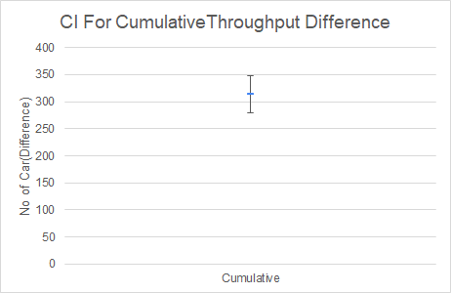
Statistical Significance
Simulation Project - Team D
Milestone #7 - Experiments
CI for (throughput in experiment model - ground truth model)

Slide 23
04
Cost & Progress
Simulation Project - Team D
Milestone #7 - Experiments

Slide 24
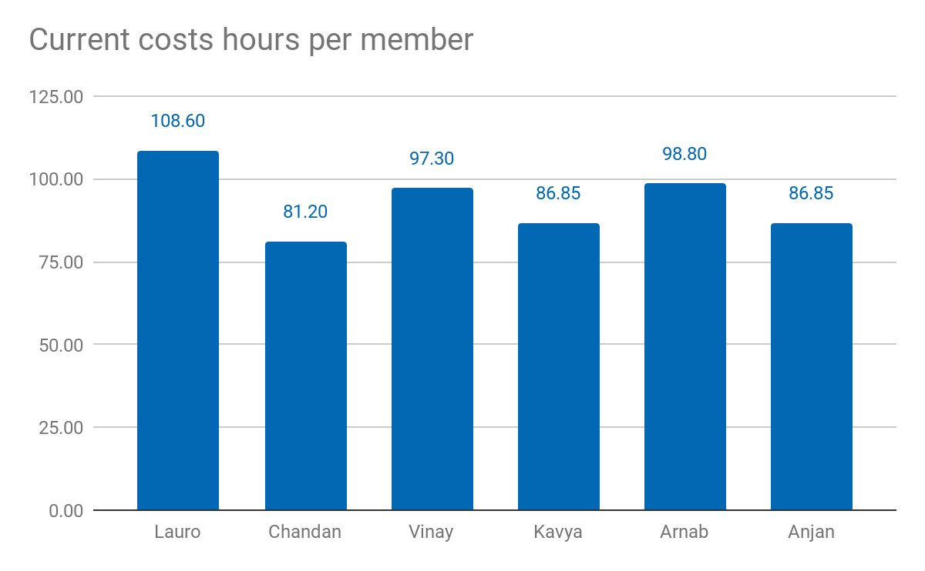
Current costs as % of total cost: 93.27%
Current costs: 55.960,00 €
Simulation Project - Team D
Milestone #7 - Experiments

Slide 25
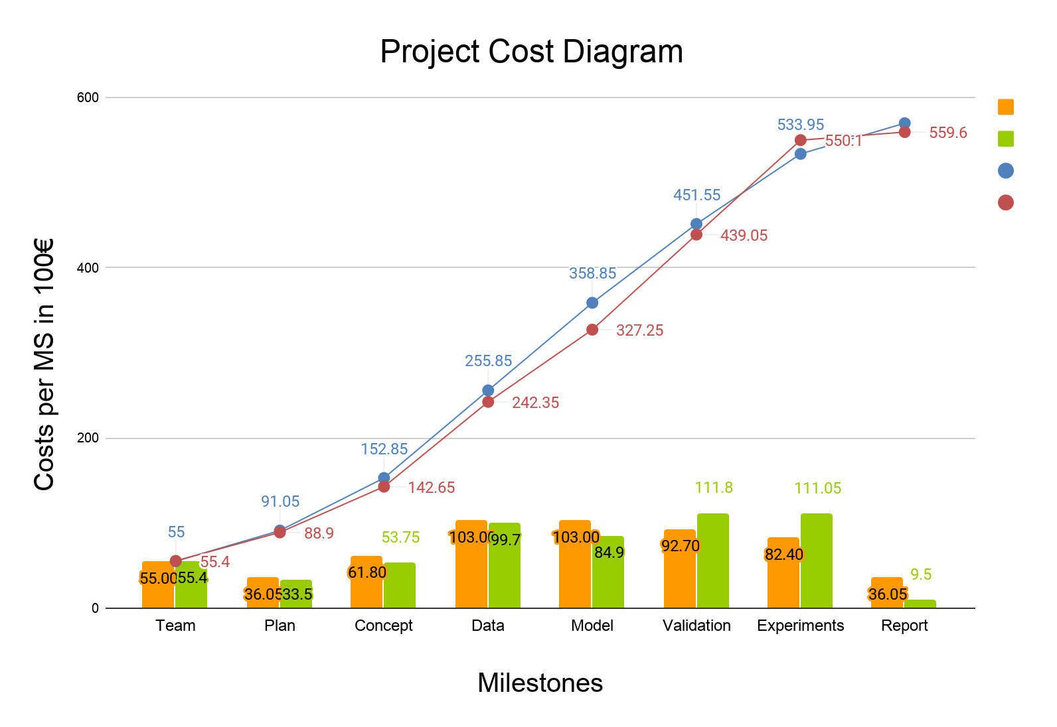
Cost Incurred
Simulation Project - Team D
Milestone #7 - Experiments
Estimated cost
Actual cost
Cumulative estimate
Cumulative actual

Slide 26
Tasks completed so far
✓
✓
✓
✓
✓
✓
✓
✓
Simulation Project - Team D
Milestone #7 - Experiments
Define team structure
Chalk out project plan
Perform data analysis
Visit and inspect the node
Create simulation model
Draw conceptual model
Perform verification and validation
Perform experiments

Slide 27
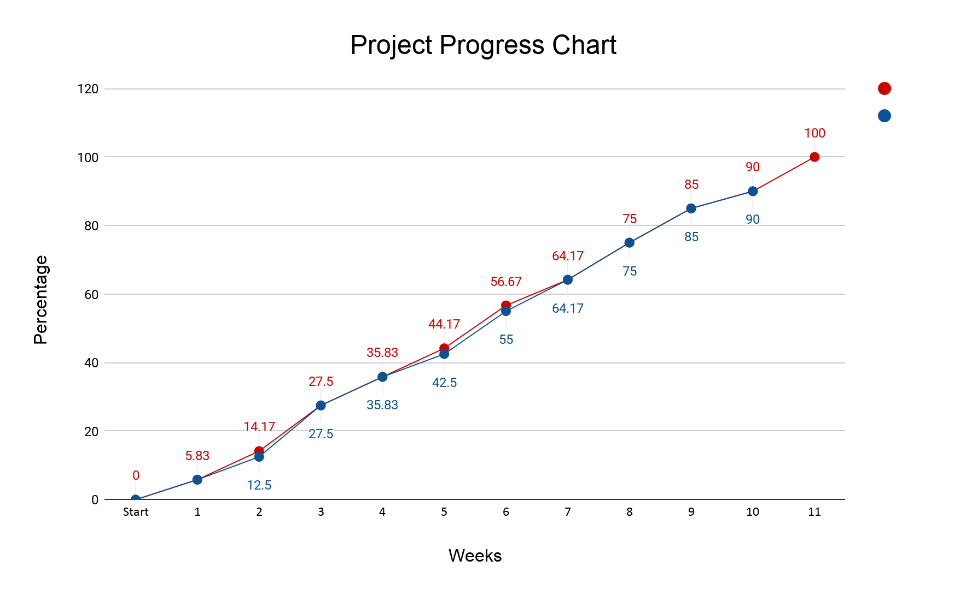
Project Progress
Simulation Project - Team D
Milestone #7 - Experiments
Plan
Actual

Slide 28
Lessons learned
01
02
05
03
04
Simulation Project - Team D
Milestone #7 - Experiments
Include the progress made slide
Drawing CI graphs are time consuming.
Early ideas are not always correct. Dropped few early experiment plans.
Experiments always do not produce expected/favourable result.
Consolidating huge numerical data is tedious, needs management skills.

Slide 29
06
Thank you!
Simulation Project - Team D
Milestone #7 - Experiments
Questions?

